Slide 1
FIT5147 Data Visualisation Project Part 1: Design
YOUR NAME
This is a read-only template file.
To use the template goto:
File > Make a Copy (to use in Canva)
OR
File > Download to .pptx (to use Powerpoint)
YOUR PROJECT TITLE
Purpose: XXX (Which insights from your DEP are you communicating in your DVP?)
Audience: XXX (Who are you designing for?)
YOU DO NOT HAVE TO USE THIS TEMPLATE
You can adjust the template as you wish based on the assignment criteria.
ALL SUBMITTED SLIDES ARE PRESENTED IN CLASS THEREFORE DO NOT ADD YOUR STUDENT ID
(REMOVE THIS TEXT)

Slide 2
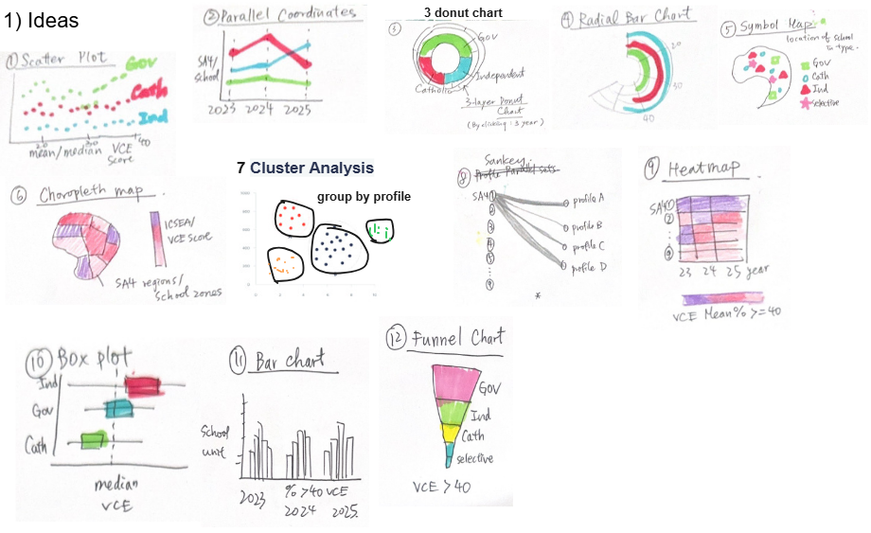
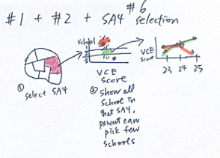
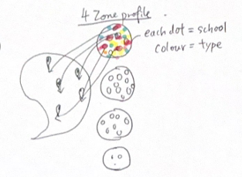
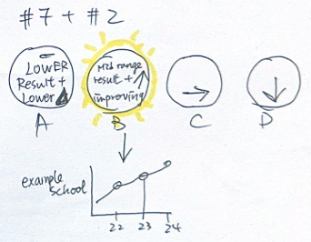
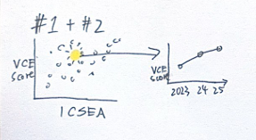
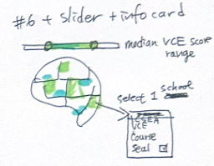
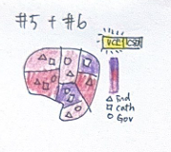
1) Ideas
Title:
Choosing a Secondary School Zone: Results, Student Backgrounds and Trends
Author:
Sin Ping CHAN
Date:
08/10/2026
Sheet:
1
Task:
Explore visualisation ideas to develop an interactive story for parents considering a move for
a secondary school zone. Help them understand school results alongside student backgrounds,
three-year trends and locations.
2) Filter
#10 Boxplot:
Requires statistical explanation that may distract parents from the story.
#11 Bar Chart:
Small differences across the 3 years do not show a clear message in this design.
3) Categorise
5) Questions
These ideas use simple visuals, short explanations and guided interactions to help busy parents follow the story without needing statistical knowledge.
Differences and relationships:
#1 Scatter Dot Plot
Change and patterns:
#2 Line Chart, #9 Heatmap
Location and regional context:
#5 Symbol Map, #6 Choropleth Map
Groups and proportions:
#3 Donut Chart, #4 Radial Bar Chart, #7 School Profile Groups
Connections and stages:
#8 Sankey Diagram, #12 Funnel Chart
Can parents understand what each profile means?
Could they mistake the profiles for a ranking of good and bad schools?
Does the animation help parents connect profiles to locations?
Is the information card short and easy to understand?
4) Combine & Refine
reveal its three-year trend and a short explanation.
Select a profile circle.
-Animate its school dots onto their map locations.
Show 4 profile circles with clear labels. Select a circle to reveal the three-year trend of an example school and a short explanation. Use colour to identify profiles
Select a school in the scatter plot to reveal its three-year trend. Explain its current results alongside recent changes.
Place school symbols over shaded regions. Show regional context and individual school locations together.
Move the slider to highlight school zones within a results range. Click a zone to open a white card explaining its associated school’s details( ICSEA, VCE score,etc) Include a close button

Slide 3
Layout
Title:
Author:
Date:
Sheet:
Task:
Operations
Discussion
Focus

Slide 4
Layout
Title:
Author:
Date:
Sheet:
Task:
Operations
Discussion
Focus

Slide 5
Layout
Title:
Author:
Date:
Sheet:
Task:
Operations
Discussion
Focus

Slide 6
Layout
Title:
Author:
Date:
Sheet:
Task:
Operations
Details
Focus

Slide 7
REFERENCES:
DECLARATION:

